Slide 1
CS1675 Recitation #6: 10/5/18
These slides are available online:
https://github.com/kc13/CS1675
Agenda for today:
Selected questions from Socrative Quizzes
10/2: 6,8,9,10,11
Logistic regression exercise

Slide 2
Socrative Quiz review requests (all for Oct. 2 quiz)
#6: If the features are one-dimensional, linear regression finds a
line that maps these features to a continuous label, and there
are two parameters of the model.
True
From regression slide 12:
Slope = w₁
y* = continuous label
Y intercept = w₀
X₁ = One dimensional feature value

Slide 3
Socrative Quiz review requests (all for Oct. 2 quiz)
#8: If we compute the gradient analytically, we are using the form
of the loss equation; if we compute it numerically, we just
need a black box that outputs loss when weights are input.
True
From regression slide 15:
From regression slides 19-25 :
analytically
numerically
Loss gradient w/
respect to change in weights
Loss function L(w) (sum of squared errors)
Approximate gradient by using a small step size h.
For each dimension of w: Ask the black box for the loss before and after the dimension is incremented by h (represented by f(x) and f(x+h) above).
Use (loss_{new} – loss_{old}) / h to estimate the gradient.
Solve at 0 to find the minimum loss

Slide 4
Socrative Quiz review requests (all for Oct. 2 quiz)
#9: Being very sensitive to the training set is always good.
False
From regression slides 56-57:
Fitting the noise instead of the underlying trend (overfitting)
As # of parameters becomes very high, estimate of underlying trend poorer; ↑ error on test set.

Slide 5
Socrative Quiz review requests (all for Oct. 2 quiz)
#10: Being very insensitive to the training set is always good.
False
From regression slides and 54 and 57:
Not enough flexibility to fit the underlying trend
As # of parameters becomes very low, estimate of underlying trend poorer; ↑ error on test set.

Slide 6
Socrative Quiz review requests (all for Oct. 2 quiz)
#11: To determine the optimal complexity of our model, we try all
complexities on the test set, and pick the model with the
lowest error on the test set.
False
Paraphrasing regression slide 69:
Do this on a validation set, not the test set.
This is often a random subset of the training data that is held out (like in Part 2 of HW4).
Performance on the validation data set is expected to be a good estimate of that which would be seen with the test set (i.e., it should be close to the red curve).
Evaluation on the test set should not occur until all decisions regarding the model are finalized.

Slide 7
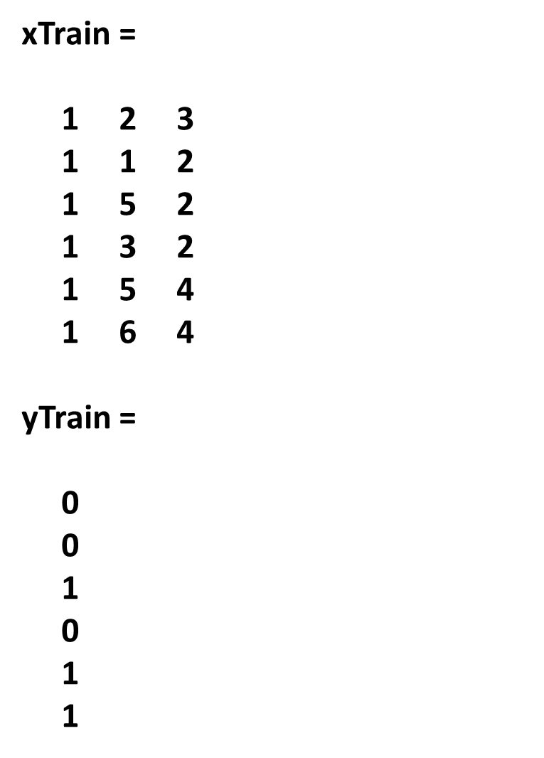
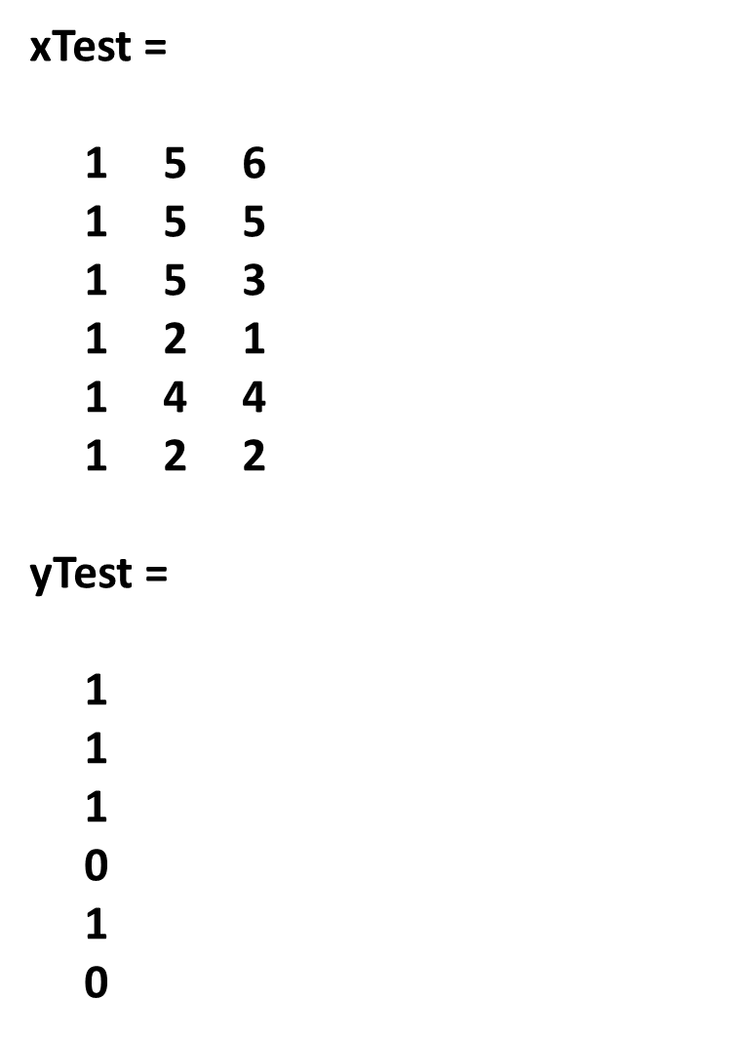
Logistic regression exercise: Data
Same as recitation 5 (KNN) except a bias term has been added to xTrain and xTest.
To access, download from here
and load into Matlab with load()
Alternatively, copy this:
https://github.com/kc13/CS1675/rec6_LR_data.mat

Slide 8
Logistic regression (with images from classification slides / whiteboard notes)
Goal: Given a vector of features, what is the probability that the correct label should be a 1?
As with linear regression, we can use a single w vector if we add a bias dimension to x.
Model:
a.k.a. sigmoid

Slide 9
For the exercise:
Use xTrain and yTrain to run 1 or more iterations of batch gradient ascent to begin the process of estimating w.
You are encouraged to do the majority of this by hand. It may help to use Matlab (or another tool) for the more tedious calculations.
We use gradient ascent because we are trying to maximize the log likelihood of seeing our data set given the weight vector.
See gradient ascent update formula on the next slide.
The weights can be initialized as a vector of 0s.

Slide 10
For the exercise:
Gradient ascent update rule (from whiteboard notes):
Where y_{i} is the training label, x_{i} is the vector of training features, η = learning rate (try .01) and σ = sigmoid function =
In words: For each training sample, find the current prediction (given the current w and the sigmoid function; note this will = 0.5 if w = [0 0 0]), then subtract this prediction from the actual label, multiply the result by the training feature vector, sum this to an ongoing accumulation of these gradient values across samples, multiply by eta, and add to the current w.

Slide 11
Solutions:
For an initial w(0) of [0 0 0]:
w(t = 1) = [0 0.0500 0.0150]
w(t = 2) = [-0.0034 0.0851 0.0196]
Do these weights make sense?
(It may help to plot the training data.)

